Slide 1
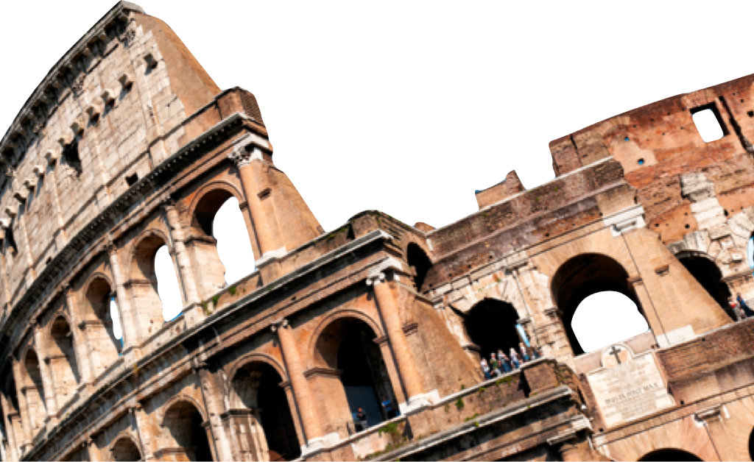
ROMANS
Response to God’s Mercy
Romans 12:1-8
Laying a solid foundation
Jesse McLaughlin

Slide 2
Romans 12:1-2
¹Therefore I urge you, brethren, by the mercies of God, to present your bodies a living and holy sacrifice, acceptable to God, which is your spiritual service of worship. ² And do not be conformed to this world, but be transformed by the renewing of your mind, so that you may prove what the will of God is, that which is good and acceptable and perfect ^{(NASB)}

Slide 3
Living and Holy Sacrifice
Imagery of Temple Sacrifice
  Priests & the Sacrifice
  What are we presenting to God?
Service of worship
  “Rational”
  Response to God’s mercy
“Do not go on presenting the members of your body to sin as instruments of unrighteousness; but present yourselves to God as those alive from the dead, and your members as instruments of righteousness to God.” Romans 6:13

Slide 4
“No worship is pleasing to God which is purely inward, abstract and mystical; it must express itself in concrete acts of service performed by our bodies.”
– John Stott

Slide 5
Nonconformity & Transformation
Conforming to this world has been identified as _________and ___________________ in the preceding text of the letter to the Roman church (Rom. 1:18-32).
Growing awareness of how we have conformed to the world and what righteousness looks like.
The work of transformation is not __________________. Our role is to submit to the Holy Scripture and the Holy Spirit. The Holy Spirit does the work of transformation.
sin
disobedience
self-effort

Slide 6
“The stages of Christian moral transformation: first our mind is renewed by the Word and Spirit of God; then we are able to discern and desire the will of God; and then we are increasingly transformed by it.”
– John Stott

Slide 7
The Will of God
Paul is writing here about the revealed precepts/laws of God that reveal to us the right way to live. God’s will for his people is that we live in righteousness.
Knowing God’s will is not seeing into the future.
“It is easier to engage in ungodly prying into the secret counsel of God than to apply ourselves to the practice of godliness”
– R.C. Sproul

Slide 8
Romans 12:3-8 (NASB)
³ For through the grace given to me I say to everyone among you not to think more highly of himself than he ought to think; but to think so as to have sound judgment, as God has allotted to each a measure of faith. ⁴ For just as we have many members in one body and all the members do not have the same function, ⁵ so we, who are many, are one body in Christ, and individually members one of another.

Slide 9
⁶ Since we have gifts that differ according to the grace given to us, each of us is to exercise them accordingly: if prophecy, according to the proportion of his faith; ⁷ if service, in his serving; or he who teaches, in his teaching; ⁸ or he who exhorts, in his exhortation; he who gives, with liberality; he who leads, with diligence; he who shows mercy, with cheerfulness.

Slide 10
Sound Judgment
Paul’s place of authority.
“As God has allotted to each a measure of faith”
  In either case, sound judgment (“sober judgement” ESV) would require all believers to admit that whatever their gifts, all are God given! No one can claim to be of superior value in the Kingdom of God.

Slide 11
Grace Gifts
Unity and diversity: We are not individuals seeking to honor God separately but a unified whole that can only function well when all the various gifts are being utilized.
Understanding the gift of prophecy
  Different than OT prophecy
  The message must be subordinate to Scripture and be inspired by the Holy Spirit. The source should not be human emotion or personal opinion.
Other gifts (not an exhaustive list): Service, teaching, exhortation, giving, leading, mercy.

Slide 12
Conclusion
In response to God’s mercy believers must surrender themselves to God in righteous living and use their God-given gifts for the good of the community.

Slide 13
Discussion Questions
In what area do you sense you have been most shaped by the world?
Do you believe God’s will is always, “good and acceptable and perfect”? Why or why not?
What are your spiritual gifts? (Note: Romans 12 does not contain an exhaustive list)

